Slide 1
Numerical Analysis (3/7) integration & differentiation
University of Luxembourg - 2024
Master in Mathematics
Hadrien Beriot
Unrestricted

Slide 2
Outline
1. Numerical integration
2. Numerical differentiation
3. Summary

Slide 3

1. Numerical Integration

Slide 4
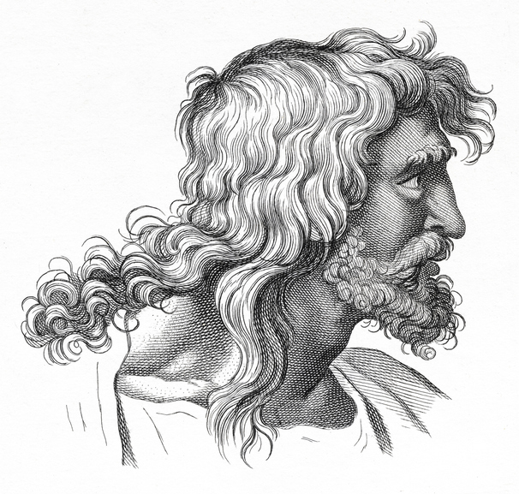
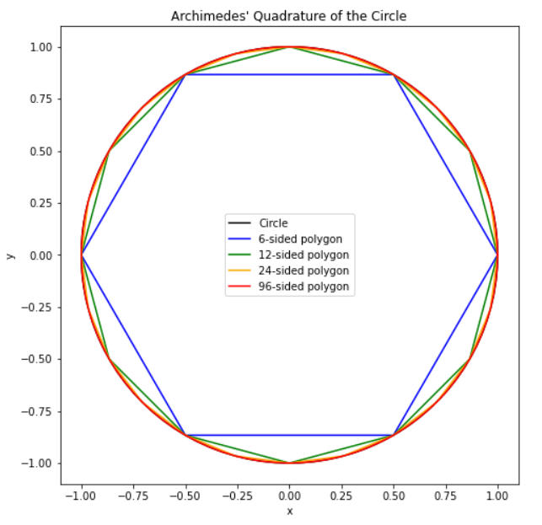

Dates back from Antiquity
In antiquity, aera approximation was know.
Approach was to tile the region with small squares and then count the number of squares within the region
Archimedes (287–212 BCE) used polygons to approximate the area of a circle.
By calculating the areas of inscribed and circumscribed polygons, he found an early approximation for $π$
He obtained by using 96 polygons
$$3.1408 < π <3.1429$$
Notes:
3.141592

Slide 5

Numerical integration
Being given a continuous function $f : [a, b] →ℝ$, we try to compute the integral
$$I=\int_{a}^{b}{f\left(x\right) dx}$$
We need to use numerical integration when we do not know the explicit form of the primitives of $f$ :
$$f\left(x\right)=e^{−x^{2}}, f\left(x\right)=\frac{e^{x}}{x}, f\left(x\right)=\frac{1}{log⁡(x)}$$
We do not want to compute exactly the value of this integral but only an approximate value $I_{app}$ with an a priori given accuracy $ε$ i.e. such that
$$|I − I_{app}| < ε$$

Slide 6
Basic principle
Once again, we “replace” the function f by a close enough function for which computing its primitive is quite easy → polynomial interpolation
However, in some occasions we must be careful with global polynomial interpolation
This is why we will most of the time adopt a piecewise polynomial approximation

Slide 7
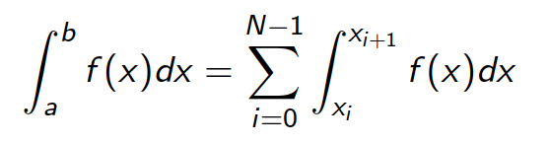

Description of the principle
We subdivide the interval $[a, b]$in some smaller intervals $a = x_{0} < x_{1} < · · · < x_{N} = b$
By linearity we have
Hence, we are led to compute some integrals for which the length of the integration interval is relatively small.

Slide 8
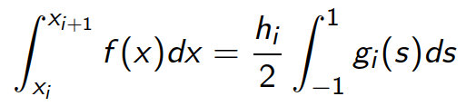
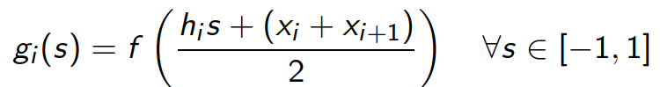
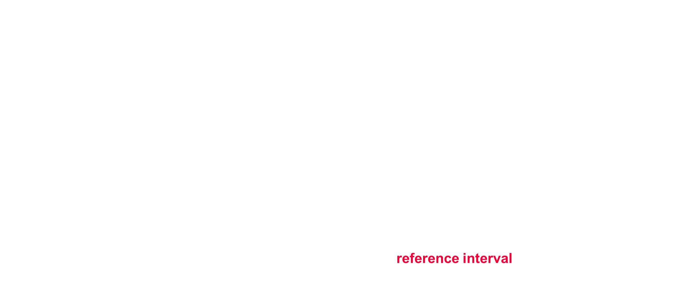
Change of variable
For each integral, the following change of variable
yields
setting
Therefore, we focus on the approximation of integrals on the reference interval $[−1, 1]$

Slide 9
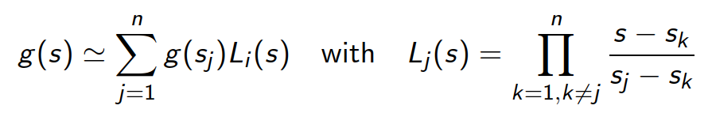
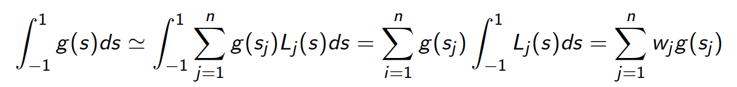



Interpolating the integrand over [-1,1]
Being given n points ${{(s}_{j})}_{1≤j≤n}$, $n > 0 in [−1, 1]$, we approximate the function $g$ by the interpolation polynomial of degree $≤ (n − 1)$ at points ${\left(s_{j}, g\left(s_{j}\right)\right)}_{\text{1≤}\text{j}\text{≤}\text{n}}$
Therefore, we have
Notes:
You can only do that with Lagrange – otherwise you cannot interpret the coefficient g(s_j) as the value of the function at s_j

Slide 10









Interpolating the integrand over [-1,1]

Slide 11









Interpolating the integrand over [-1,1]

Slide 12
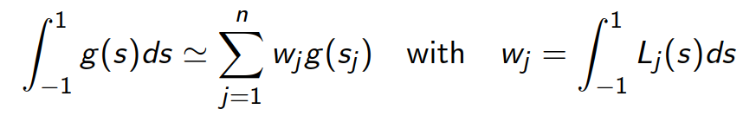

Interpolating the integrand over [-1,1]
We have obtained
if $g$ is a polynomial of degree $≤ n − 1$ then it coincides with its interpolation polynomial and the formula is exact.
We have $\sum_{j=1}^{n}{w_{j}=2}$(because $\sum_{j=1}^{n}{L_{j}(s)=1} →$partition of unity)

Slide 13
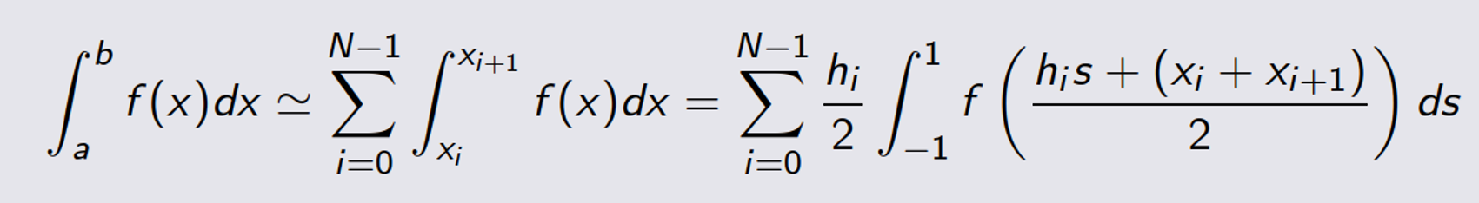
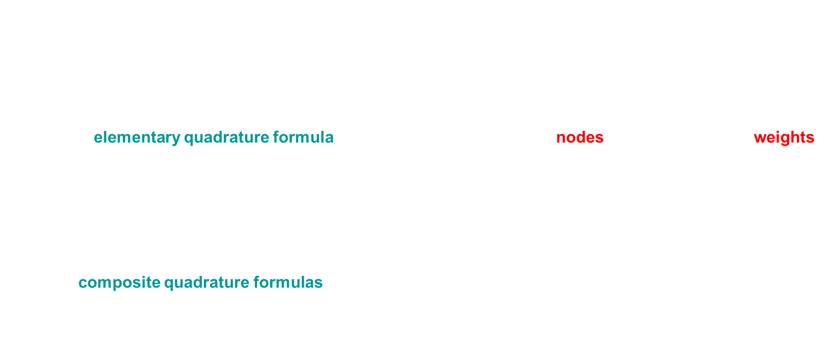
Quadrature formula - definition
The formula
Is called elementary quadrature formula with $n$ stages. The ($s_{j}$) are the nodes and the ($w_{j}$) are the weights
By linearity the formula
Leads composite quadrature formulas

Slide 14
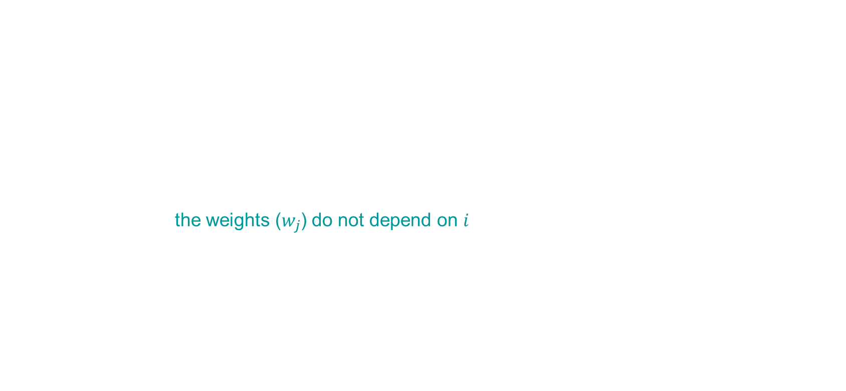
Quadrature formula
Remarks:
Composite formulas can be obtained directly by replacing $f$ by its piecewise interpolant
The interest of coming back to a fixed interval $[−1, 1]$ is to allow a unified treatment that is independent of the interval $[x_{i} , x_{i+1}]$
It shows that the weights ($w_{j}$) do not depend on $i$ !
We will now derive various quadrature rules thanks to interpolation

Slide 15
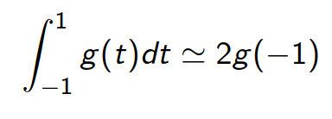
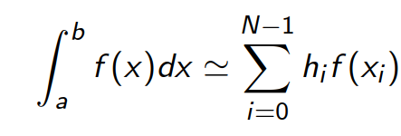
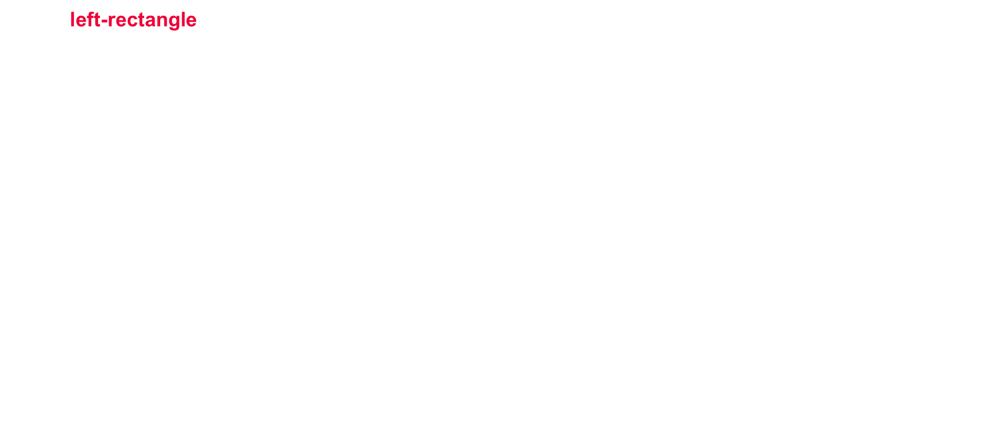
Example: Left-rectangle
the left-rectangle formula (0th order polynomial with $x_{0} =−1$)
Composite rule

Slide 16
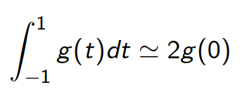
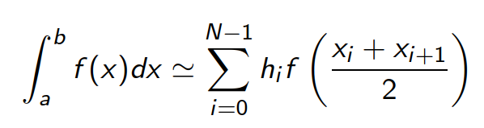

Example: Mid-point rule
the midpoint formula (0th order polynomial with $x_{0} = 0$)
Composite rule

Slide 17
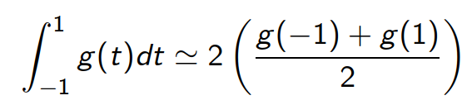
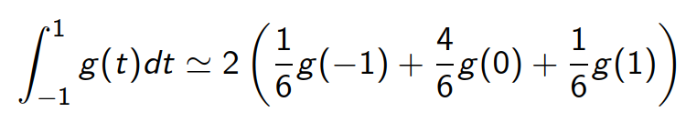

Trapezoidal and Simpson’s rules
the trapezoidal formula (1st order polynomial with $x_{0} =−1, x_{1}=1$)
the Simpson’s quadrature rule (2nd order polynomial with $x_{0} = −1, x_{1} = 0, x_{2} = 1$)

Slide 18
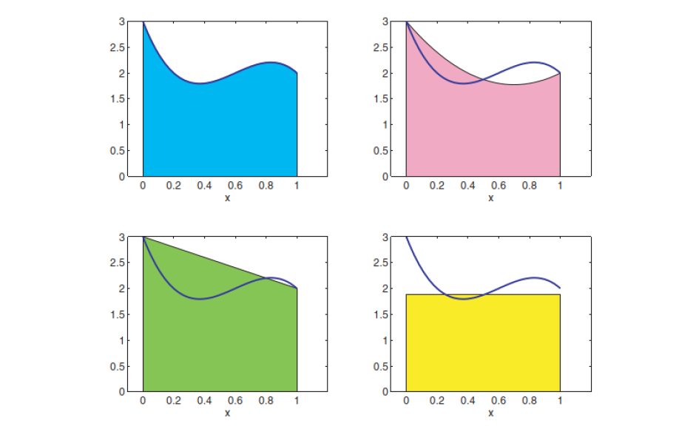
Elementary quadrature rules
Simpson
Rule | Points | Weights
Left-rectangle | -1 | 2
Midpoint | 0 | 2
Trapezoidal | -1, 1 | 1, 1
Simpson | -1, 0, 1 | 1/3, 4/3, 1/3
Trapezoidal
Midpoint
Exercise 1

Slide 19
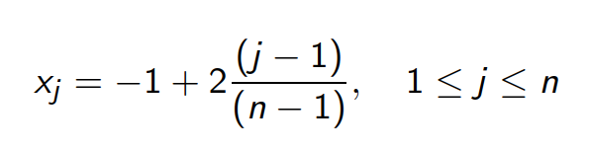
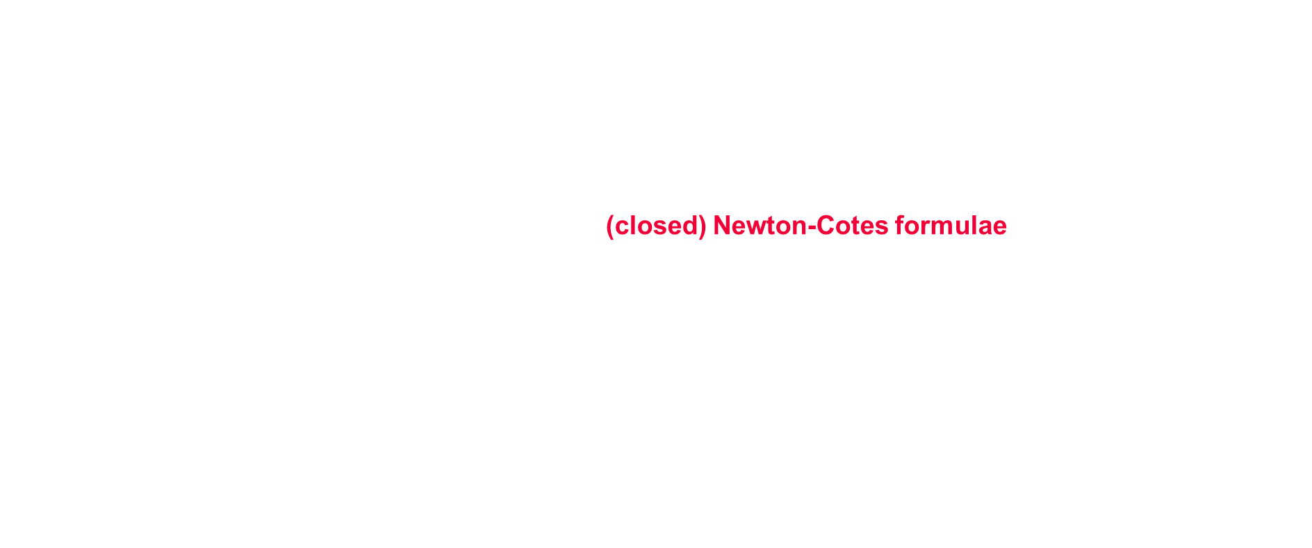
Newton-Cotes formulae
More generally, if we choose equidistant nodes ($x_{j}$) in the quadrature formulas $(n > 1)$
the quadrature formulae ${\left(x_{j} , w_{j}\right)}_{1≤j≤n}$ are called (closed) Newton-Cotes formulae.
for $n (n ≥ 10)$ large, the weigths ($w_{j}$) explode and the signs are mixed which implies that the formulae are very sensitive to round-off errors
some coefficients start to be such that $w_{j} < 0$ for $n ≥ 9$
This implies that the Newton-Cotes formulas are Unrestricted to $n ≤ 8$

Slide 20
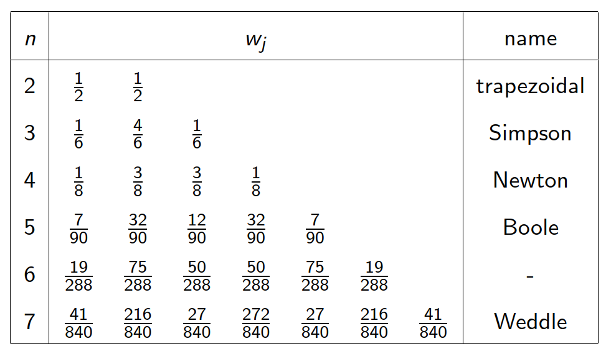
The Newton-Cotes formulas

Slide 21
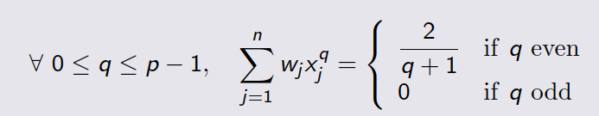


Order of accuracy of elementary quadrature
We say that a $n$ stages elementary quadrature formula ${\left(x_{j} , w_{j} \right)}_{1≤j≤n}$ is of order $p$ if the integration formula is exact for any polynomial of degree less or equal to $p − 1$
By construction, a $n$ stages elementary quadrature formula is at least of order $n$
A $n$ stages elementary integration formula ${\left(x_{j} , w_{j} \right)}_{1≤j≤n}$ is of order p if and only if
Notes:
Beware that n is the number of quadrature points and p is the order of the polynomial

Slide 22
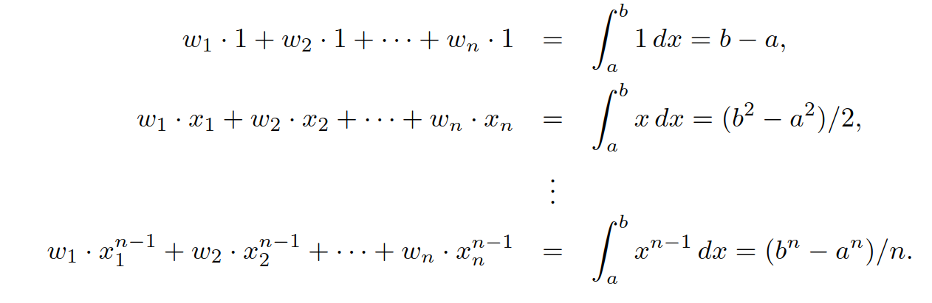

An alternative approach
An alternative method for deriving quadrature rules, is to choose the weights so that the rule integrates the ﬁrst $n$ polynomial basis functions exactly, which results in
This is the Method of Undetermined Coeﬃcients

Slide 23





Slide 24
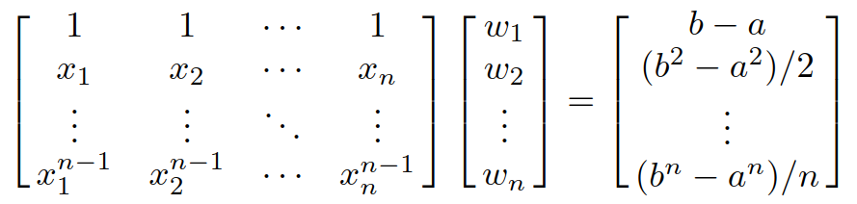

An alternative approach
The matrix of this system is a Vandermonde matrix, which is nonsingular because the nodes $x_{i}$ are assumed to be distinct
The unique solution of this system yields the weights $w_{1}, . . . , w_{n}$, which are the same as those given by integrating the Lagrange basis functions.
Here you do not use Lagrange or ty to fit a polynomial, you just try to set the weights for fixed points
Exercise 2

Slide 25




Exercise
Let try $n = 3$with the points $x_{1} = −1, x_{2} = 0 and x_{3} = 1$

Slide 26
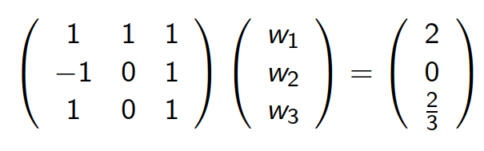
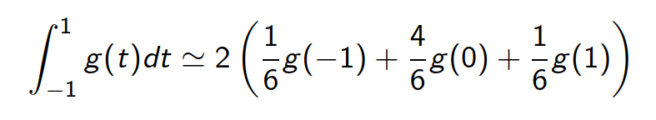






Exercise
Let try n = 3 with the points $x_{1} = −1, x_{2} = 0 and x_{3} = 1$
Derive the 3 weights for these 3 points
We find the Simpson’s formula

Slide 27
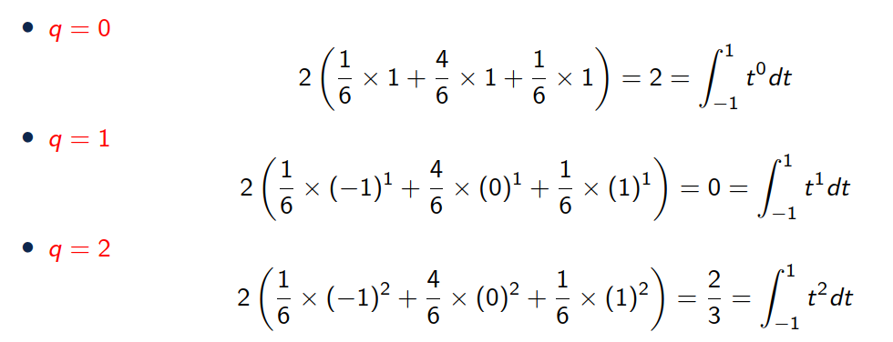
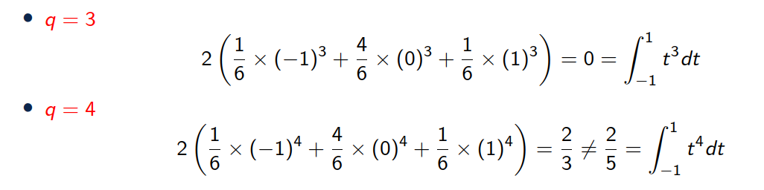





Simpson’s formula: checking our result
Simpson’s quadrature
Checking our results
So we see that the 3-stage Simpson rule is at least of order 3 (it integrates $p=2$)
But what is interesting is that if we continue
we see that the 3-stage Simpson rule is of order 4 (it integrates $p=3$)
This is a general property for symmetrical elementary quadrature formulas.

Slide 28
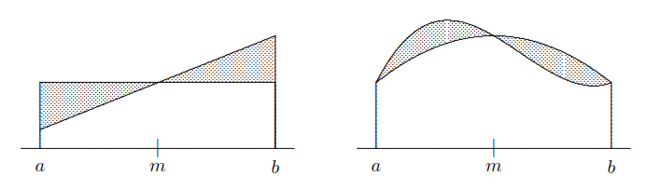
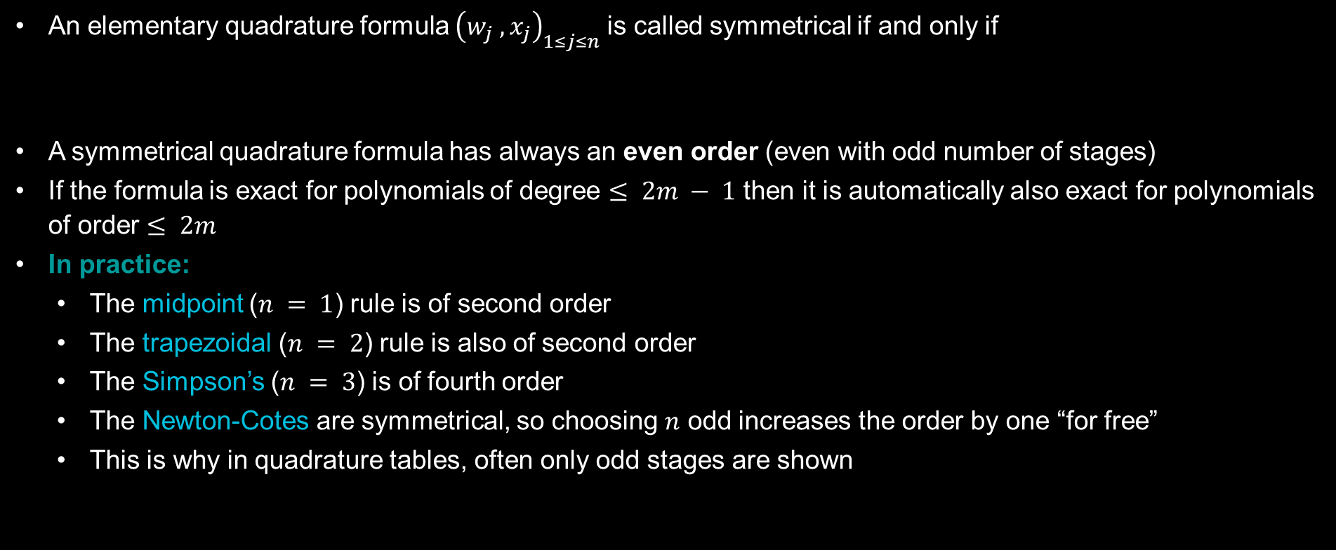
Symmetrical quadrature is always of even order
An elementary quadrature formula ${\left(w_{j} , x_{j}\right)}_{1≤j≤n}$is called symmetrical if and only if
A symmetrical quadrature formula has always an even order (even with odd number of stages)
If the formula is exact for polynomials of degree $≤ 2m − 1$ then it is automatically also exact for polynomials of order $≤ 2m$
In practice:
The midpoint ($n = 1$) rule is of second order
The trapezoidal ($n = 2$) rule is also of second order
The Simpson’s ($n = 3$) is of fourth order
The Newton-Cotes are symmetrical, so choosing $n$ odd increases the order by one “for free”
This is why in quadrature tables, often only odd stages are shown
Exercise 3

Slide 29
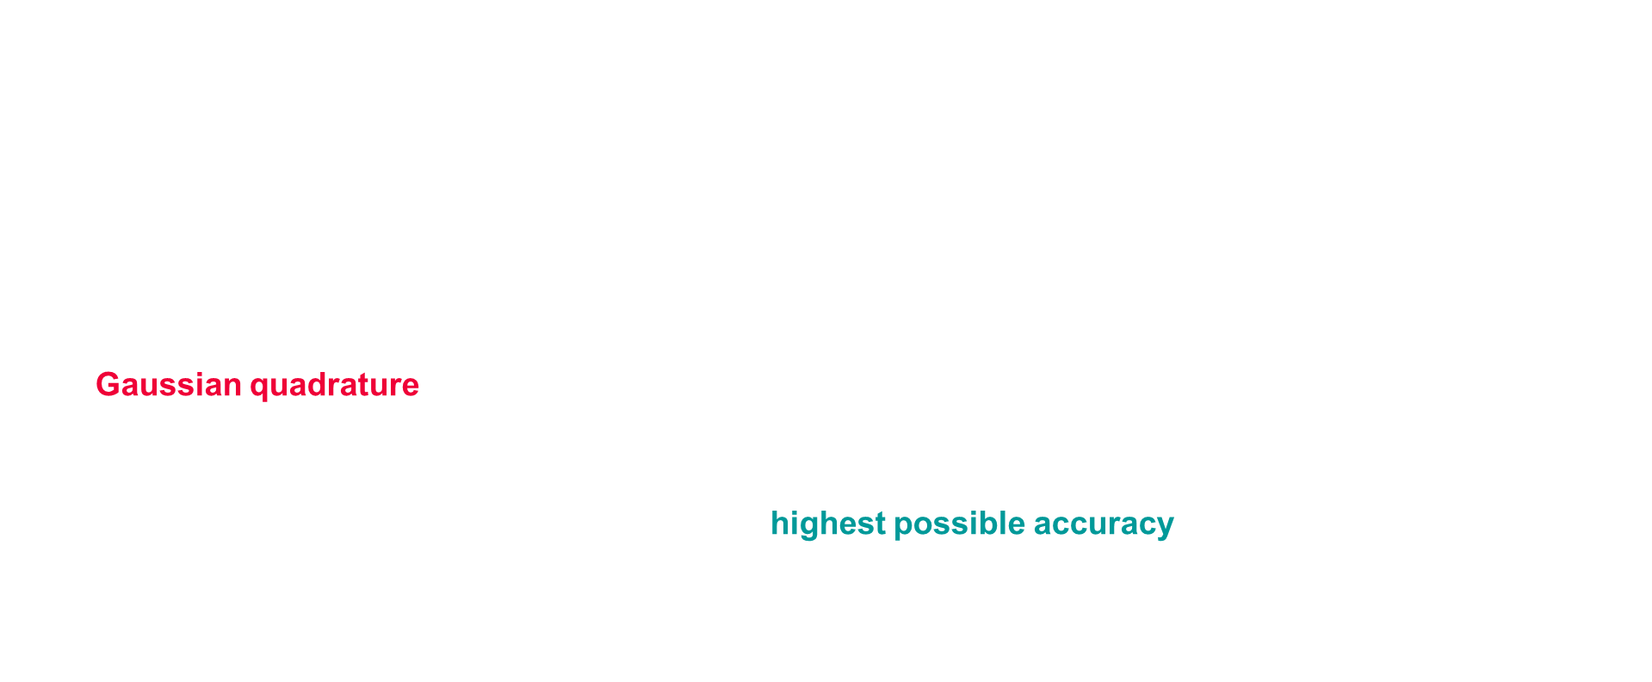
Gaussian quadrature
So far, the $n$ nodes were prespeciﬁed and the $n$ weights were chosen
With only $n$ parameters free to be chosen, the resulting degree is generally $n − 1$
What if we now also optimize the location of the nodes?
That would lead to $2n$ free parameters ${\left(x_{j} , w_{j} \right)}_{1≤j≤n}$
Maybe a degree of $2n−1$ is achievable?
In Gaussian quadrature, both the nodes and the weights are optimally chosen to maximize the degree of the resulting quadrature rule.
In general, for each $n$ there is a unique $n$-point Gaussian rule, and it is of degree $2n − 1$.
Gaussian quadrature rules therefore have the highest possible accuracy for the number of nodes used, but they are signiﬁcantly more diﬃcult to derive than Newton-Cotes rules.

Slide 30




Slide 31


Gaussian Quadrature Rule
To illustrate the derivation of a Gaussian quadrature rule, we will derive a two-point rule on the interval $\left[−1, 1\right]$, choosing $w_{1}, x_{1}, w_{2}, x_{2}$ up to order $2n−1=3$
Notes:
Tip: choose a symmetric one → exercise

Slide 32
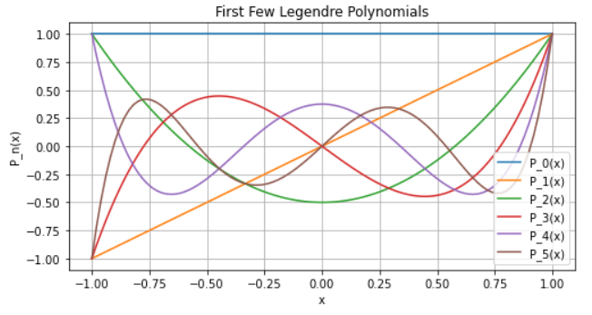
Orthogonal polynomials
Nodes of Gaussian quadrature rules are obtained from the zeroes of orthogonal polynomials.
Gauss-Legendre polynomials, obtained from the roots of the Legendre polynomials are the most famous
They are present in most scientific codes requiring integration

Slide 33

Orthogonal polynomials
An orthogonal polynomials of order $n$ is orthogonal to all polynomials of degree less than $n$ (can you see why?)
$$\int_{−1}^{1}{P_{n}\left(x\right)⋅r\left(x\right)dx}=0$$
Where $r(x)$ is any polynomial of degree $n−1$
This property is crucial because it allows us to construct optimal quadrature rules with $2n−1$ degree

Slide 34


Why It Works for Degree $2n−1$
Consider any polynomial $f(x)$ of degree $2n−1$. We can express $f(x)$ as
$$f\left(x\right)=q\left(x\right)+P_{n}\left(x\right)⋅r\left(x\right)$$
where $q(x)$ is a polynomial of degree less than $n$, and $r(x)$ is a polynomial of degree $n−1$
When we integrate $f(x)$, we get
$$\int_{−1}^{1}{f\left(x\right)dx= }\int_{−1}^{1}{q\left(x\right)dx}+\int_{−1}^{1}{P_{n}\left(x\right)⋅r\left(x\right)dx}$$
So
$$\int_{−1}^{1}{f\left(x\right)dx= }\int_{−1}^{1}{q\left(x\right)dx}$$
Since $q(x)$ is a polynomial of degree less than $n$, the Gaussian quadrature rule with $n$ nodes corresponding to the roots of $P_{n}(x)$ exactly integrates $q(x)$, ensuring that $f(x)$ is also exactly integrated.
Notes:
We do not know q(x), but we know that at the roots of the Legendre polynomials q(x) = f(x)!

Slide 35
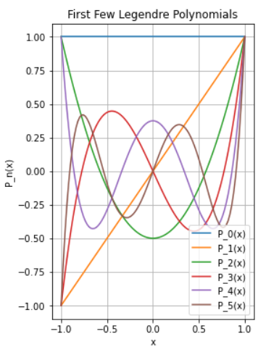
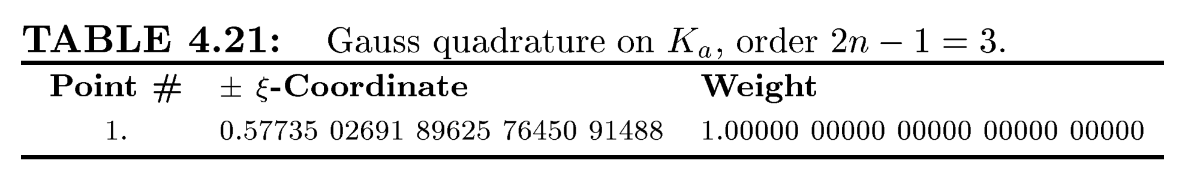
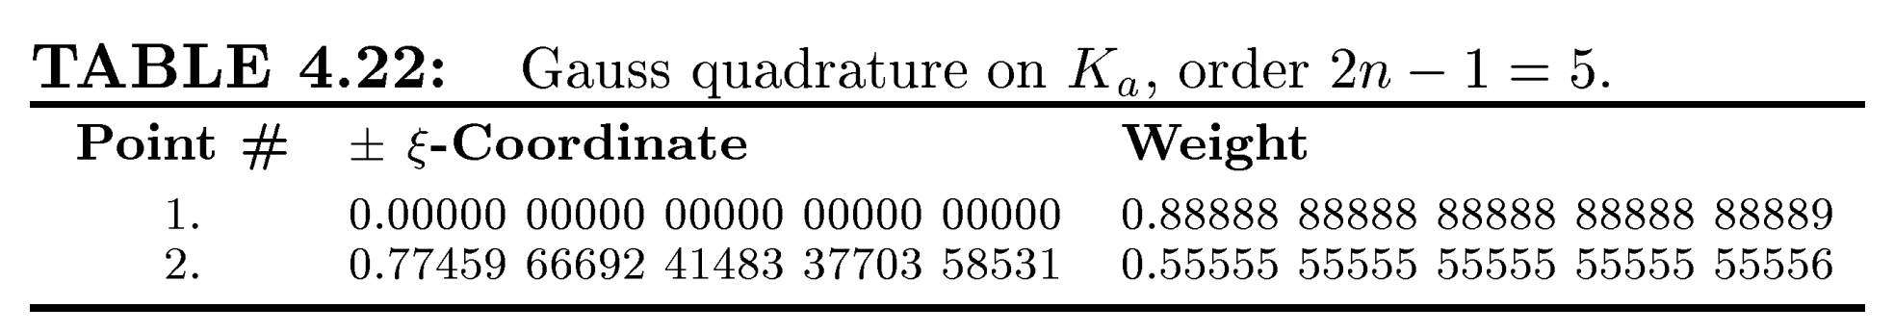

Gauss quadrature
Legendre Polynomial Roots:
Using $n$ roots of the Legendre polynomial ensures we can integrate any polynomial up to degree 2n−1 exactly.
This minimizes error, making Gauss(-Legendre) quadrature the most efficient for polynomial integrals.
Exercise 4

Slide 36

Progressive Quadrature rules (Kronrod rules)
Purpose:
Extend an existing Gauss quadrature rule by adding extra points to increase accuracy without changing the interval.
Concept:
Start with an $n−$point Gauss quadrature rule.
Add $n+1$ additional points to create a new rule with $2n+1$ nodes (the Kronrod rule).
Kronrod rule is designed to keep all Gauss nodes and add new ones to improve accuracy
Applications:
Efficient error estimation: Combine the Gauss and Kronrod rules to approximate the integral and estimate the error from their difference.
Commonly used in adaptive quadrature algorithms to control accuracy.
Example:
The Gauss-Kronrod ($G_{7}, K_{15}$) rule uses 7 Gauss points and extends to 15 points for a higher accuracy approximation and error estimation.

Slide 37
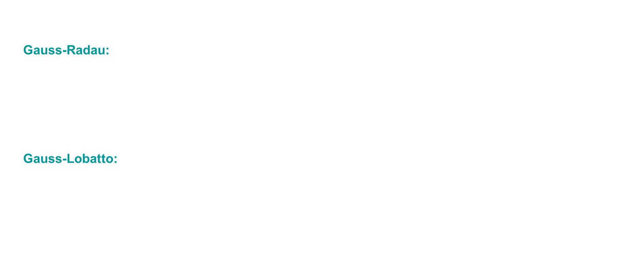
Alternative Gaussian quadratures
Gaussian quadrature do not include end points, in some occasions it is useful
Gauss-Radau:
In Gauss Radau quadrature, one of the endpoints of the interval of integration is prespeciﬁed as a node, leaving the remaining $n − 1$nodes, as well as all $n$ weights, free to be chosen to maximize the degree of the resulting rule
There are $2n − 1$ free parameters, so an $n$-point Gauss-Radau rule has degree $2n − 2$
Gauss-Lobatto:
In Gauss-Lobatto quadrature, both endpoints of the interval of integration are prespeciﬁed as nodes, leaving the remaining $n − 2$ nodes, as well as all $n$ weights, free
There are $2n −2$ free parameters, so an $n$-point Gauss-Lobatto rule has degree $2n −3$

Slide 38
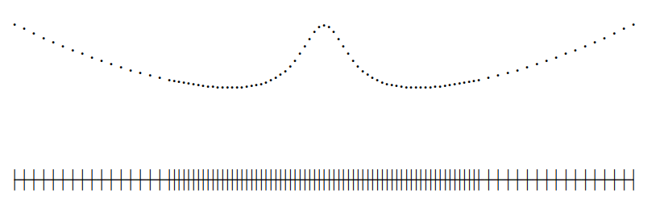
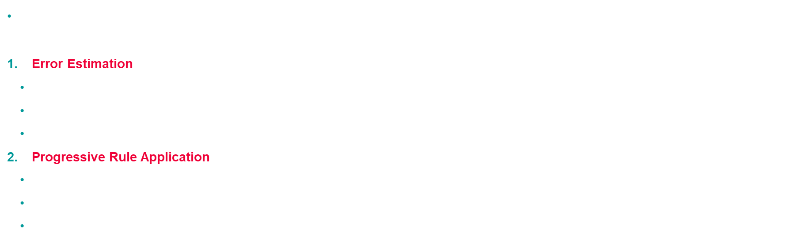
Adaptive quadrature rule
Adaptive Quadrature is a composite rule which refines the interval of integration selectively, focusing more sampling points in areas where the integrand is difficult to approximate.
Error Estimation: Use two quadrature rules, $Q_{n_{1}}$ and $Q_{n_{2}}$​, whose difference estimates the error.
Trapezoid and Midpoint Rules: Basic
Higher-Degree Rules: More efficient, e.g., Gauss-Kronrod (G7, K15)
Simpson’s Rule: Uses a single rule at two levels of subdivision.
Progressive Rule Application:
Apply both rules on the initial interval $[a,b]$
If the estimated error exceeds tolerance, divide the interval and repeat on each subinterval.
Continue until all subintervals meet the desired accuracy tolerance.
Typical placement of evaluation points by adaptive quadrature routine

Slide 39
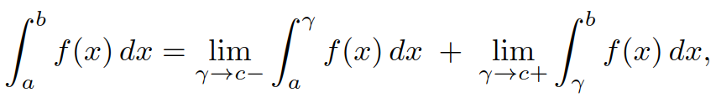

Improper Integrals
If either the integrand or the interval is unbounded, then it may still be possible to deﬁne an improper integral
For an integrand with a singularity (i.e. unbounded at a point c ∈ [a, b]), the improper integral is deﬁned as
Provided that $f$ is integrable on any subinterval and the indicated limits exist and are ﬁnite.
Best approach for dealing with a singularity in the integrand is to remove the singularity either by
transforming the variable of integration
dividing out / subtracting oﬀ an analytically integrable function having the same singularity
Exercise 5

Slide 40

















Slide 41

Improper Integrals
Exercise 5 - correction

Slide 42
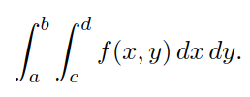
Double Integrals
There are different strategies
Use a pair of adaptive one-dimensional quadrature routines, one for the outer integral and the other for the inner integral. Each time the outer routine calls its integrand function, the latter in turn calls the inner quadrature routine.
Use a Cartesian product rule. Such rules result from applying one-dimensional quadrature rules in successive dimensions. This approach is limited to regions that can be decomposed into rectangles.
Use a nonproduct interpolatory cubature rule. Such rules, with error estimates, are available for a number of standard regions, the most important of which for adaptive use is triangles, since many two-dimensional regions can be eﬃciently triangulated to any desired level of reﬁnement.

Slide 43

Multiple Integrals
Purpose: Efficiently compute integrals in high-dimensional spaces
Concept:
Sample the function at $n$ random points within the integration domain.
Get the average of these function values & multiply by volume of the domain to estimate the integral.
Advantages:
Scales well with dimension: Unlike traditional methods, Monte Carlo integration’s cost does not grow exponentially with the number of dimensions.
error reduction: The error decreases as $\frac{1}{\sqrt{n}}$​, where $n$ is the number of sample points.
Application:
Widely used in fields requiring high-dimensional integration, such as statistical physics, finance, and machine learning.
Exercise 6

Slide 44
2. Numerical Differentiation

Slide 45
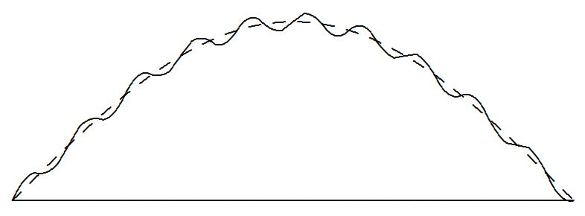
Numerical differentiation
Diﬀerentiation is an inherently sensitive problem: small data perturbations → large changes in the result
Integration, on the other hand, is a smoothing process and is inherently stable in this respect.
This contrast is not surprising, since they are inverse processes to each other
Consider the function below and a perturbed/noisy version of it
➔ Integral estimate will only be marginally affected, whereas derivatives estimates will be drastically modified

Slide 46
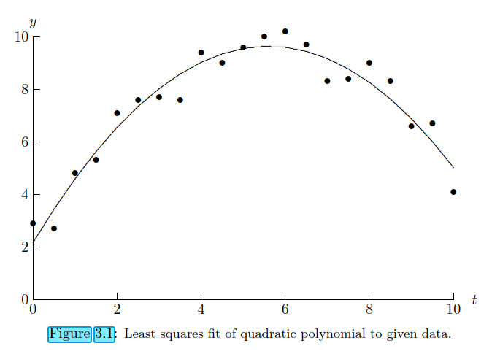
Interpolation vs smoothing
Main approach for derivative approximation consists in fitting a smooth function to discrete data points, then differentiate this function to estimate derivatives
Interpolation vs smoothing: one should use interpolation if data is smooth; for noisy data, a smoothing approach (like least squares polynomials or splines) is preferable.
Here, would you interpolate or would you smooth?
If the 21 data points were ﬁt exactly by a polynomial of degree 20, derivatives would be erratic…
By contrast derivative of the quadratic polynomial is well behaved and insensitive to data changes

Slide 47
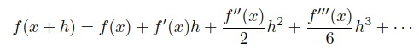
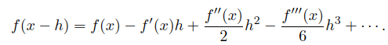
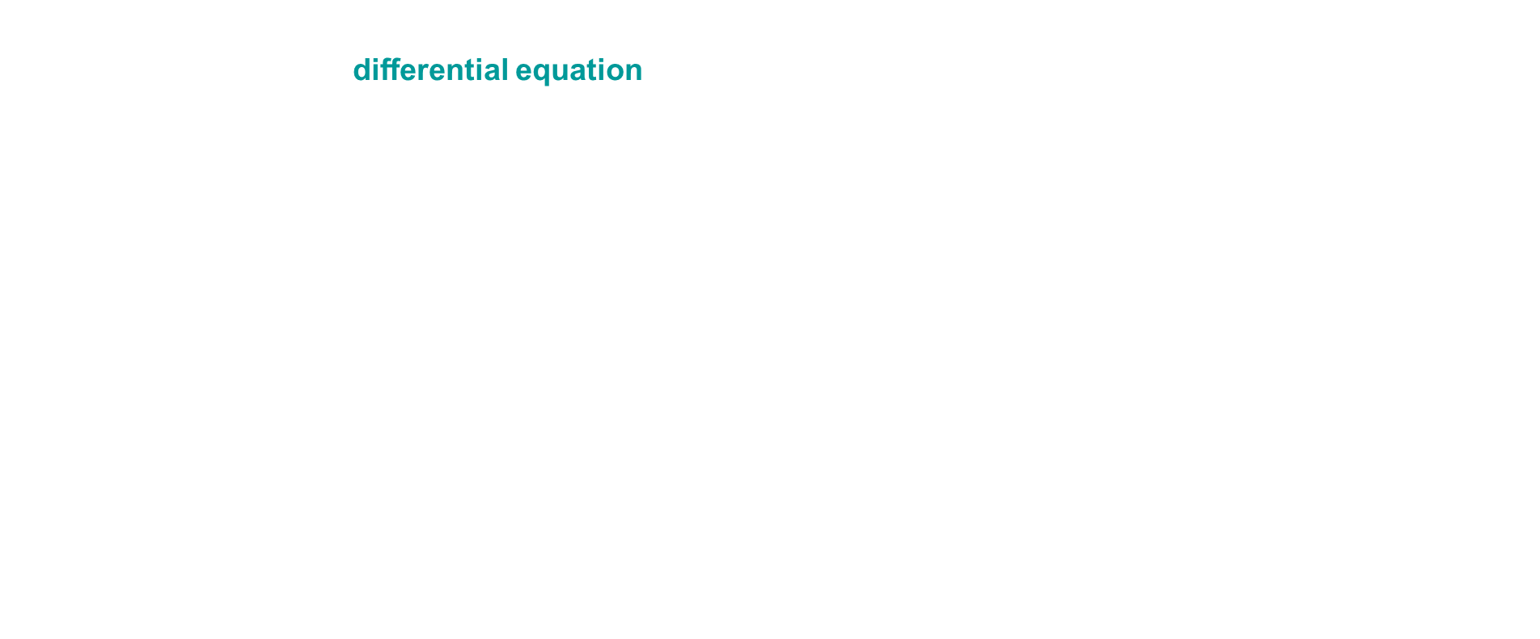
Finite Difference
Although not appropriate for noisy data, finite differences are good for smooth functions known analytically or deﬁned implicitly by a diﬀerential equation
Given a smooth function $f:ℝ→ℝ$, we wish to approximate its ﬁrst and second derivatives at a point $x$.
For a given step size $h$, consider the Taylor series expansions

Slide 48
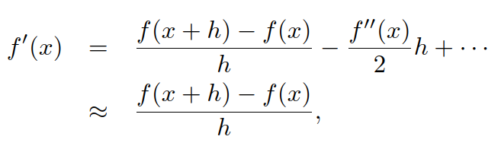
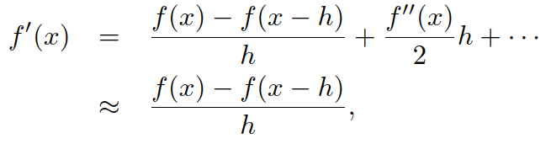
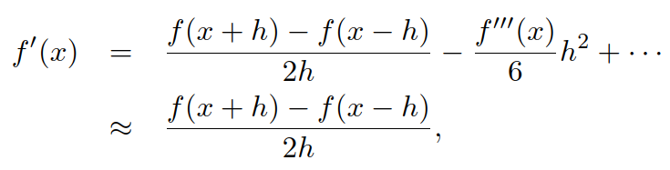


Finite difference
We obtain the forward diﬀerence formula and the backward difference formula (ﬁrst-order accurate $O(h)$)
Combining them yields the centered formula (second-order accurate $O(h^{2})$)
Centered formula for the second derivative (second-order accurate $O(h^{2})$)
Exercise 7

Slide 49
Automatic Diﬀerentiation
For any function expressed by a computer program, alternative is automatic diﬀerentiation
A computer program = basic arithmetic operations & simple functions
Thus, derivatives can be propagated through the program by repeated use of the chain rule step by step along with the function itself
The result is the true derivative of the original function, subject only to rounding error but suﬀering no discretization error.
Several eﬀective software packages are now available for automatic diﬀerentiation
Some of these packages accept a Fortran or C input program and then output a second program for computing the desired derivatives
Other packages use operator overloading to perform derivative computations automatically along with the function evaluation.
Allows determining the sensitivity of the output of a program to perturbations in its input parameters

Slide 50
3. Summary

Slide 51

Summary
Numerical integration:
Elementary quadrature rules typically yield $n−1$ order accuracy
Gaussian rules yield $2n−1$ order by optimizing both quadrature weights and points
Dividing original domain (composite rules) possibly with adaptivity is often the best choice
For high-dimensional domains, Monte Carlo integration is the method of choice
Numerical differentiation:
Highly sensitive to noise in the data (by contrast to integration)
For smooth known or implicit functions (PDE), finite difference formulas are typically used
Obtained from Taylor expansion (forward, backward, centered) or from polynomial interpolation

